Slide 1


Database systems project
Media viewing model
Notes:
Good Morning Everyone. Today my group and I will be presenting our media viewing model for the database systems project.

Slide 2

Group Members
KEAMOGETSE MOOKI
JOSHUA MARTIN
JOCELYN ATWELL
Notes:
These are the members in our group.

Slide 3
Outline
Focus:
Entertainment Industry is popular currently.
Movies and Series. IMDB website chosen due to its popularity.
Notes:
Before we get into the model we’ve created. Ill be discussing the outline, aim and the extraction process of the data.
For the outline we have decided to work with movies and series. The reason why we chose this is because the media entertainment industry is a rapidly growing industry is variety of data out there we could work with.
We decided to work with the IMDB website for movies and tv show streaming. We have also chosen this particular website because of its large amount of data.

Slide 4
AIMS
Took movies and series from website to create a database application to interact with data.
Making it easier for users to choose their movie or series their interested in based on the attributes given for each.
Notes:
The Aim of our project was to take the movies and series from the website to create a database application to interact with the data. The user would have the ability to choose their movies or series based off of their favourite genre, from the age restriction or from the ratings on the media.

Slide 5
Extraction Process
Notes:
Next we will look at how the data was extracted and the process thereof.

Slide 6
DATA EXTRACTION
Webscrapping used to gather data from media streaming website IMDB
Scraped top action movies and series
Action genre is popular
Table has 500 entries, duplicated deleted, final table had 50 entries
The dash between years used to identify movies and series
Exporting into csv dash was 2 strange letters; it was changed back to a dash.
Notes:
Webscrapping was used to gather our data. Webscrapping is a process in which data is extracted from websites to get information from raw extracted data.
The data we scraped from comes from the webpage TOP ACTION RATED MOVIES AND TV SHOWS. The reason for this is that the website only allows you to view the media through a specific genre in which each main genre has its own url. We have chosen action because it is the most popular genre in the entertainment industry today.
The data we scraped contained 500 entries. However after cleaning the data and removing the duplicates we ended up with 50 entries. We also used the dash between the years to differentiate movies and series. Media where the year contains a dash would be classified as series due to its duration. If there is no dash it would be classified as a movie.
Another problem we came across was when exporting the finalised table into a csv file, the dashes changed into two strange letters, but we used find and replace to switch it back to a dash.

Slide 7
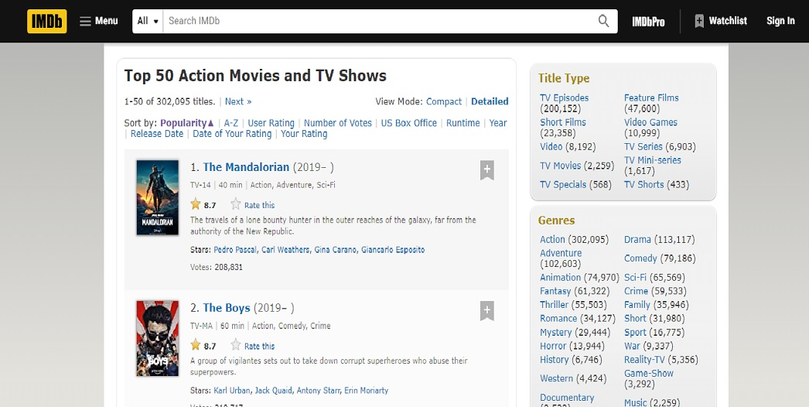
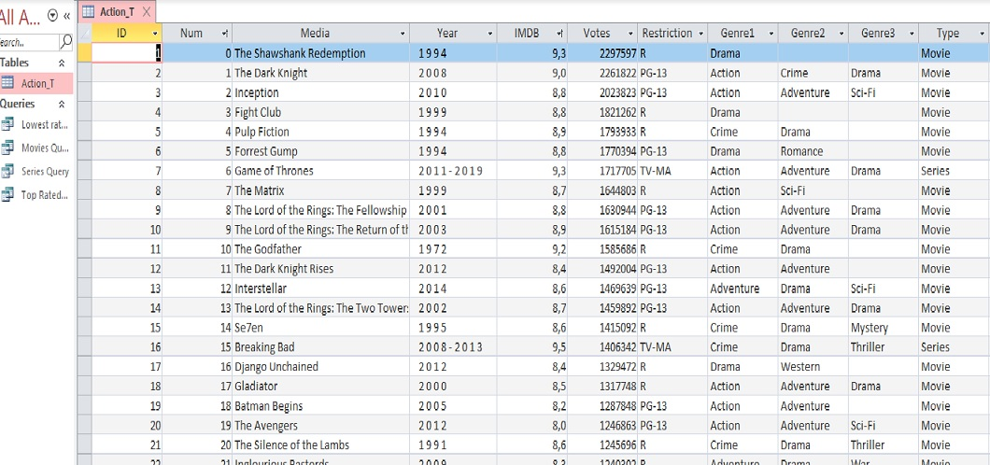
Data extraction
website
Final Table
Notes:
The image on the left displays the website we scraped from With the first series being the Mandalorian and the second being the boys.
The image on the right is the finalised table after exporting it.

Slide 8
Analysis of results
Data testing
Notes:
Next we will be looking at the analysis of results and data testing.

Slide 9
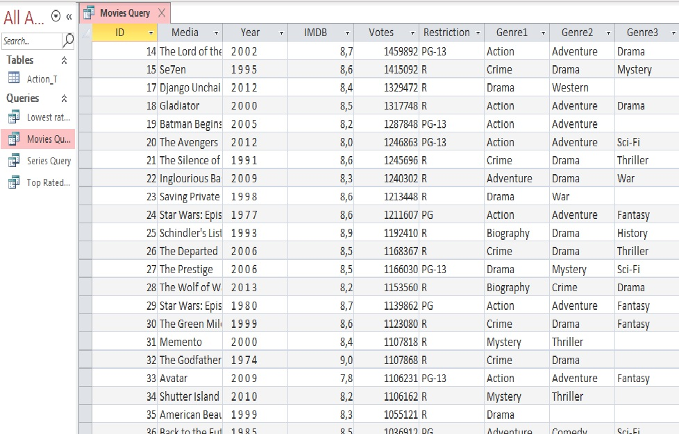
Access queries
Movies query shows all movies from the main table
There were 48 entries extracted
Out of 50 entries in the main table we can see movies are more popular with the action genre
SQL CODE:
SELECT Action_T.ID, Action_T.Media, Action_T.Year, Action_T.IMDB, Action_T.Votes, Action_T.Restriction, Action_T.Genre1, Action_T.Genre2, Action_T.Genre3
FROM Action_T
WHERE (((Action_T.Type)="Movie"));
Notes:
The table on the right is the first query we created in access which displays all the movies from the final table excluding the series.
There were 48 entries for movies alone. From which we can see that movies are more popular in the entertainment industry when it comes to the movie genre than series are. These finding could be biased because we decided to work with such a small dataset.
Below you can see the sql code to get the table you see before you.

Slide 10
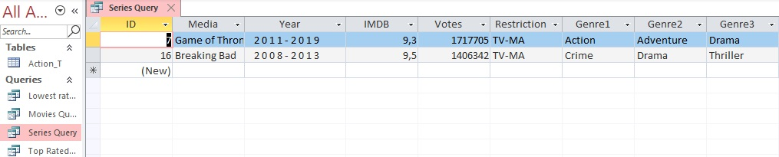
Access queries
Series query shows all series from main table
Only 2 entries were found
We can see action genre is most popular with movies than with series
SQL CODE:
SELECT Action_T.ID, Action_T.Media, Action_T.Year, Action_T.IMDB, Action_T.Votes, Action_T.Restriction, Action_T.Genre1, Action_T.Genre2, Action_T.Genre3
FROM Action_T
WHERE (((Action_T.Type)="Series"));
Notes:
The table on the right displays the query showing all series excluding the movies.
There were only 2 entries. From this we can see that series is not popular based on the action genre.
The sql code for that table is displayed at the bottom as well.

Slide 11
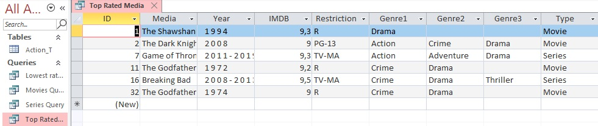
Access queries
Top rated queries shows media with a rating between 9 and 10.
There are only 6 top rated media where 4 are movies and 2 are series
SQL CODE:
SELECT Action_T.ID, Action_T.Media, Action_T.Year, Action_T.IMDB, Action_T.Restriction, Action_T.Genre1, Action_T.Genre2, Action_T.Genre3, Action_T.Type
FROM Action_T
WHERE (((Action_T.IMDB) Between 9 And 10));
Notes:
With this table we created a query named top rated media where it displays all the top rated media with a rating between 9 and 10.
There were only 6 entries in this query. Within these 6 entries, 4 were movies and 2 were series. This means that majority of media in the final table are moderately rated media between 7 and 8,9.

Slide 12
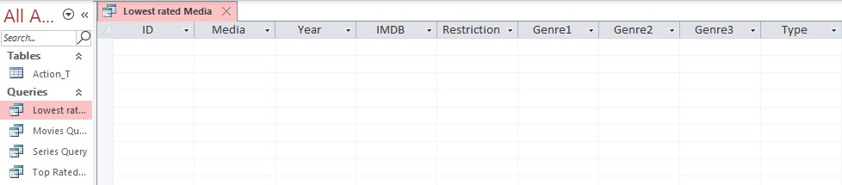
Access Queries
Lowest rated media query shows lowest rated media between 1 and 6,9.
There are no entries in this query.
Showing that all the data has high ratings from 7 to 10.
This makes our data biased and eliminates any outliers.
SQL CODE:
SELECT Action_T.ID, Action_T.Media, Action_T.Year, Action_T.IMDB, Action_T.Restriction, Action_T.Genre1, Action_T.Genre2, Action_T.Genre3, Action_T.Type
FROM Action_T
GROUP BY Action_T.ID, Action_T.Media, Action_T.Year, Action_T.IMDB, Action_T.Restriction, Action_T.Genre1, Action_T.Genre2, Action_T.Genre3, Action_T.Type
HAVING (((Action_T.IMDB) Between 1 And 6));
Notes:
The final query we created was lowest rated media which displays media with a rating between 1 and 6.9.
As you can see the table has no entries meaning that there are no movies and series that have low rating. This supports the idea that our data might be biased as outliers are eliminated and our ratings are all fairly good ranging from 7 to 10.
Now I will be handing over to my colleagues to continue this presentation.

Slide 13
Normalisation

Slide 14
normalisation
Used to clean up the data.
We split the table into two and removed the type column leaving us with a movie table and a series table.
Two tables movie and series do not have an entity relationship.

Slide 15
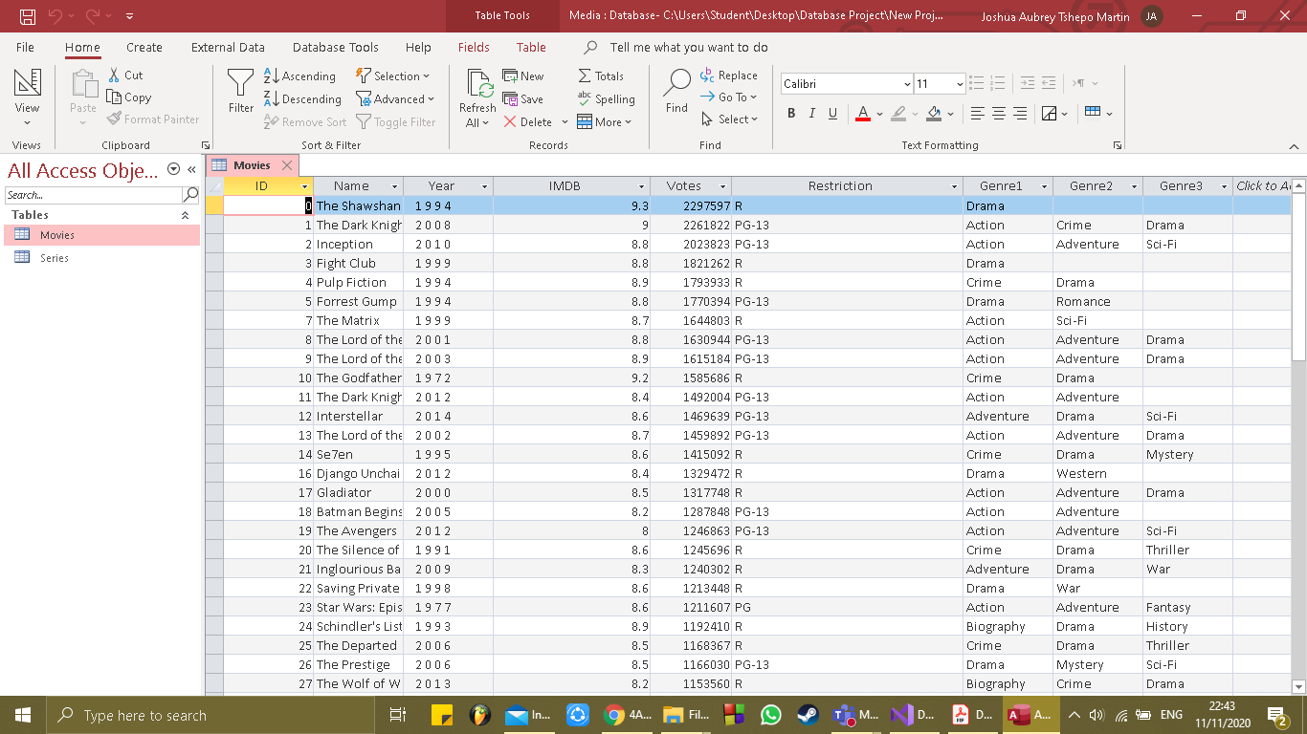
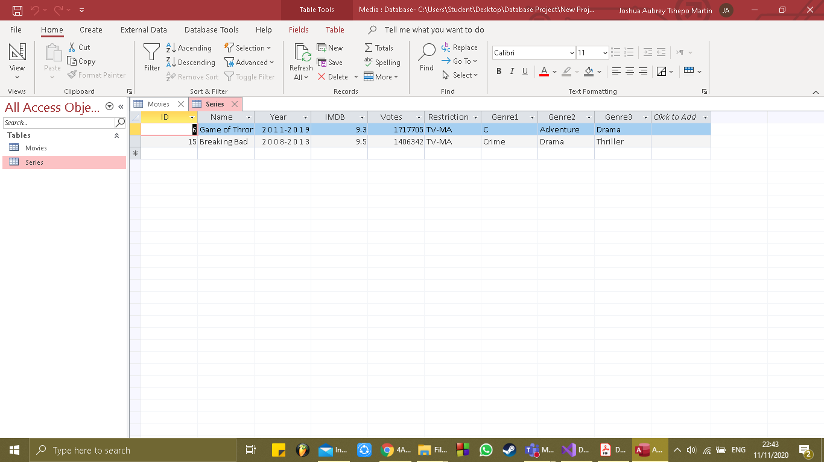
Tables
Movies Norm T
Series Norm T

Slide 16
Database application
Interactive model

Slide 17
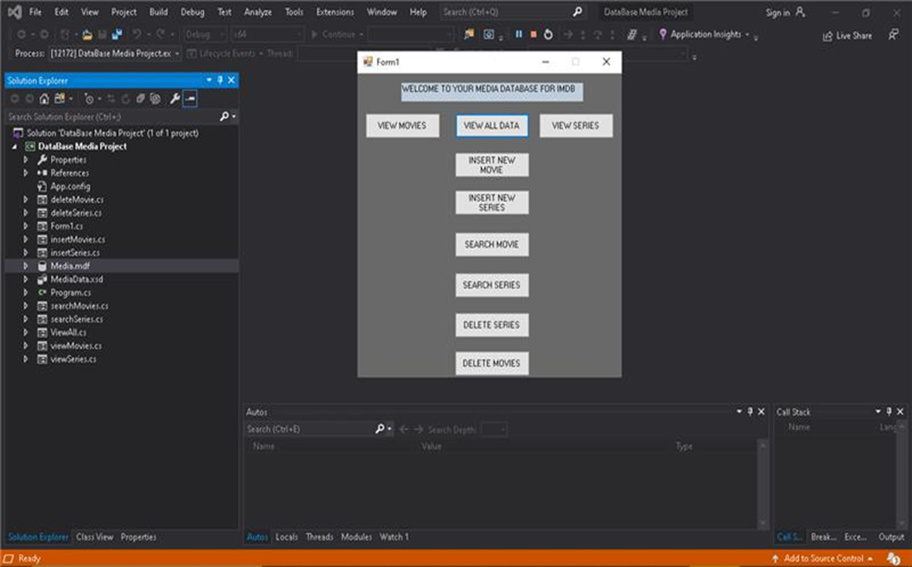
Database application
Created a user interface using Visual C#(Visual Studio)

Slide 18
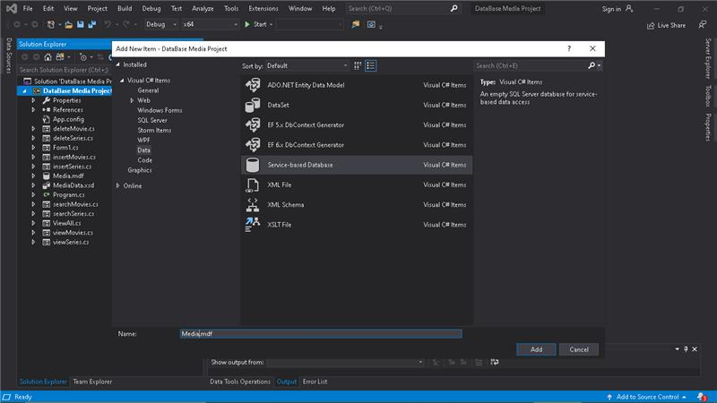
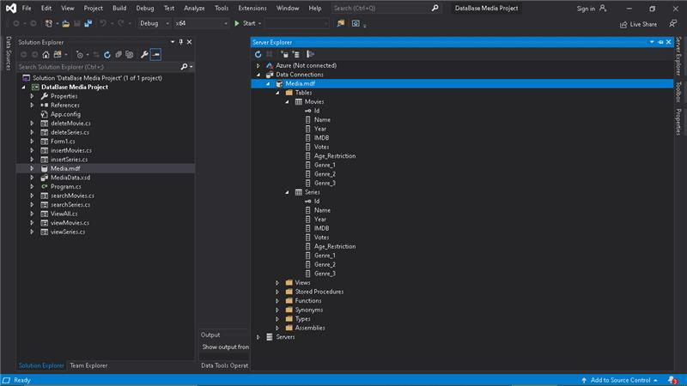
CREATING THE DATABASE
We created a database server
We then created the tables

Slide 19

DESIGNING THE USER INTERFACE
We decided that there should be different functions such as an option to view all the data, view only the series, to view only the movies, to insert new data, to delete data and to search the data.

Slide 20
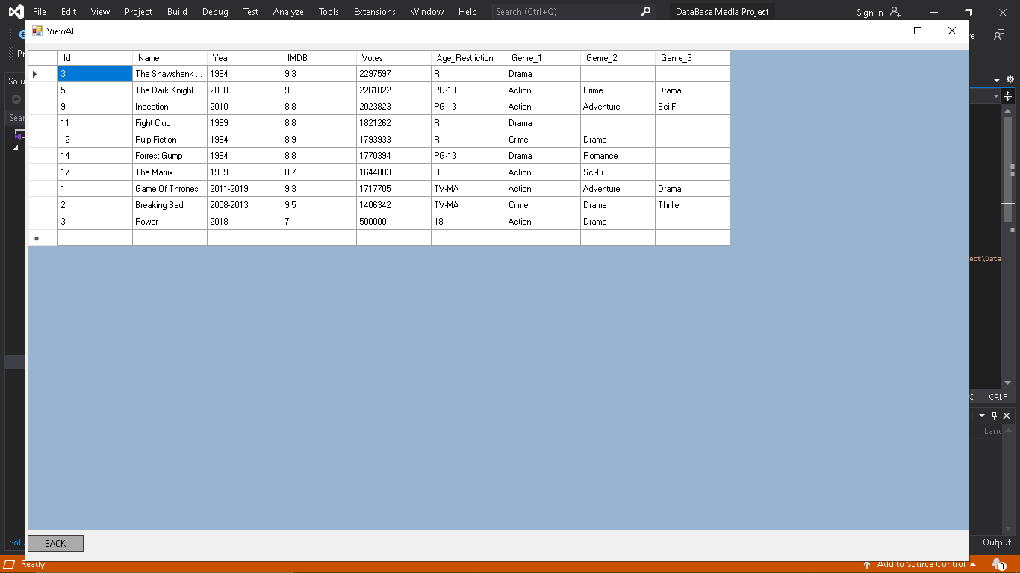
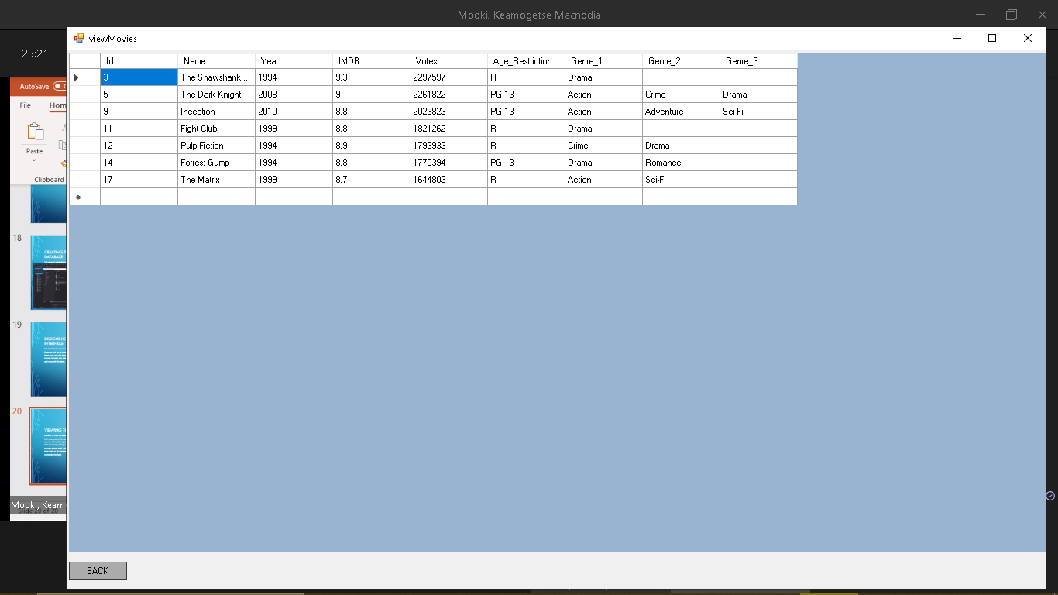
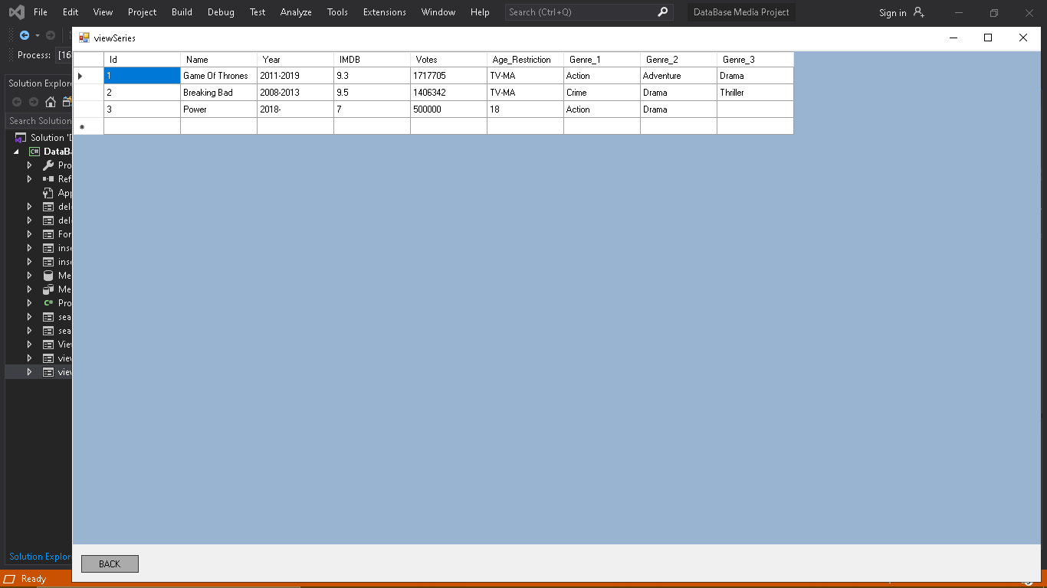
VIEWING THE DATA
select * from movies union all select * from series;
In order to view the data in the back end we had to connect to the database and run queries with each respective viewing function such as viewing series, viewing all and viewing movies each with their own specific query had to be executed and programmed to display the data
Select * from movies;
Select * form series

Slide 21
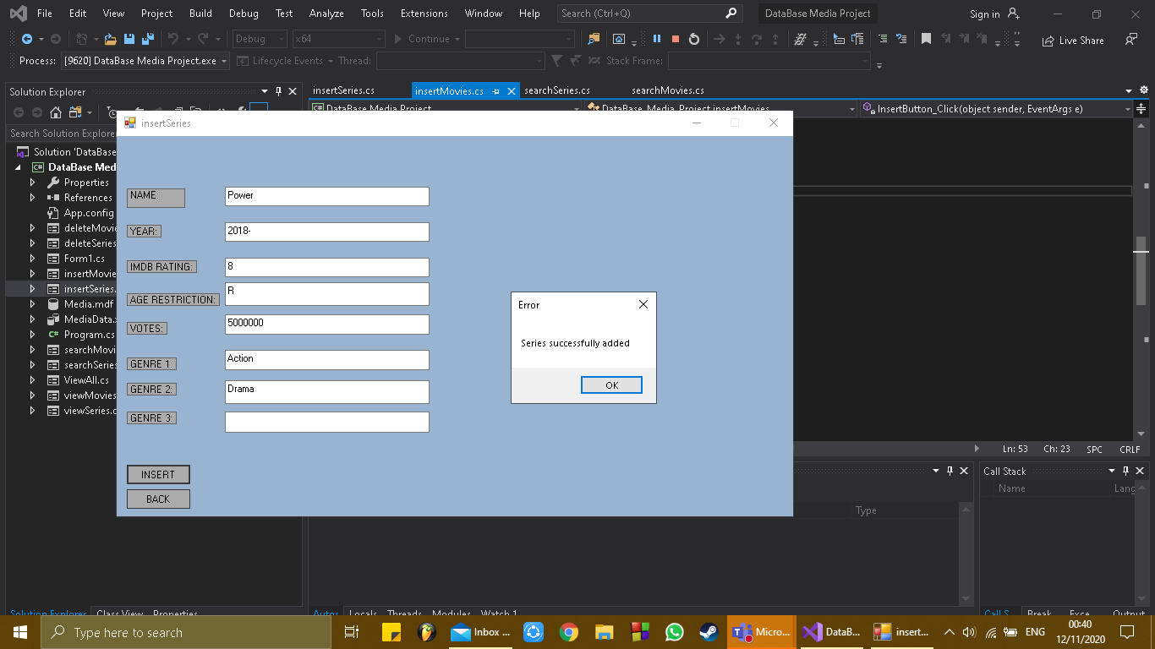
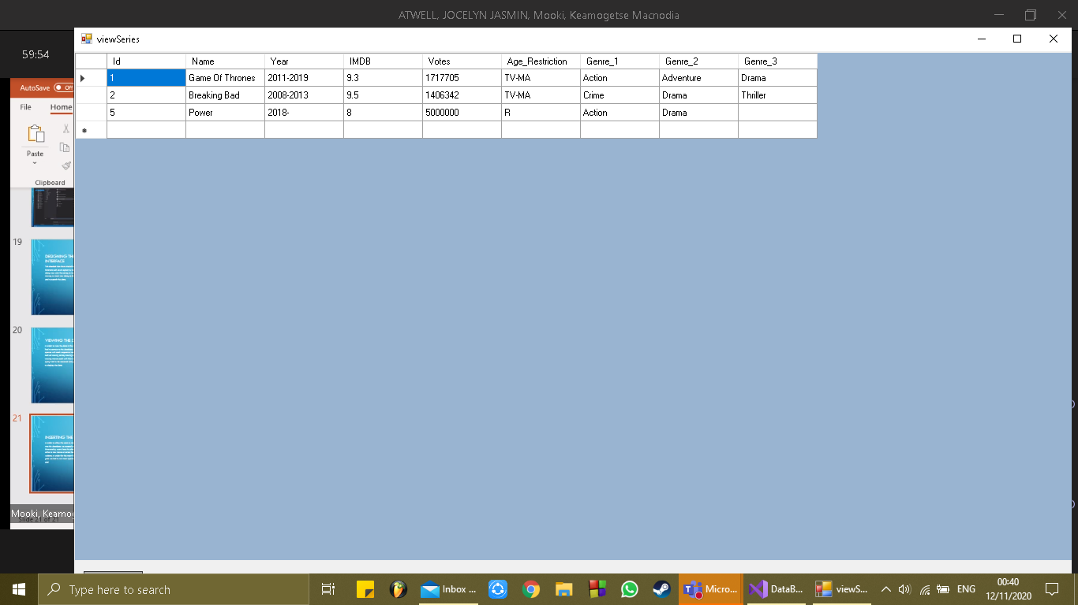
INSERTING THE DATA
insert into series(Name,Year,IMDB,Votes,Age_Restriction,Genre_1,Genre_2,Genre_3) VALUES ('" + name + "','" + year + "'," + rating + "," + votes + ",'" + age + "','" + genre1 + "','" + genre2 + "','" + genre3 + “’)
In order to allow the users to insert new data into the database we created an insert functionality. Users have the choice to insert either a new movie or series from the IMDB website. In order for the insert functions to pass we had to run insert queries at the back end
insert into movies(Name,Year,IMDB,Votes,Age_Restriction,Genre_1,Genre_2,Genre_3) VALUES ('" + name + "','" + year + "'," + rating + "," + votes + ",'" + age + "','" + genre1 + "','" + genre2 + "','" + genre3 + "'

Slide 22
SEARCHING THE DATA
In order to create functions where by the user is able to search for specific movies and /or series more back end sql queries and programming had to run.

Slide 23
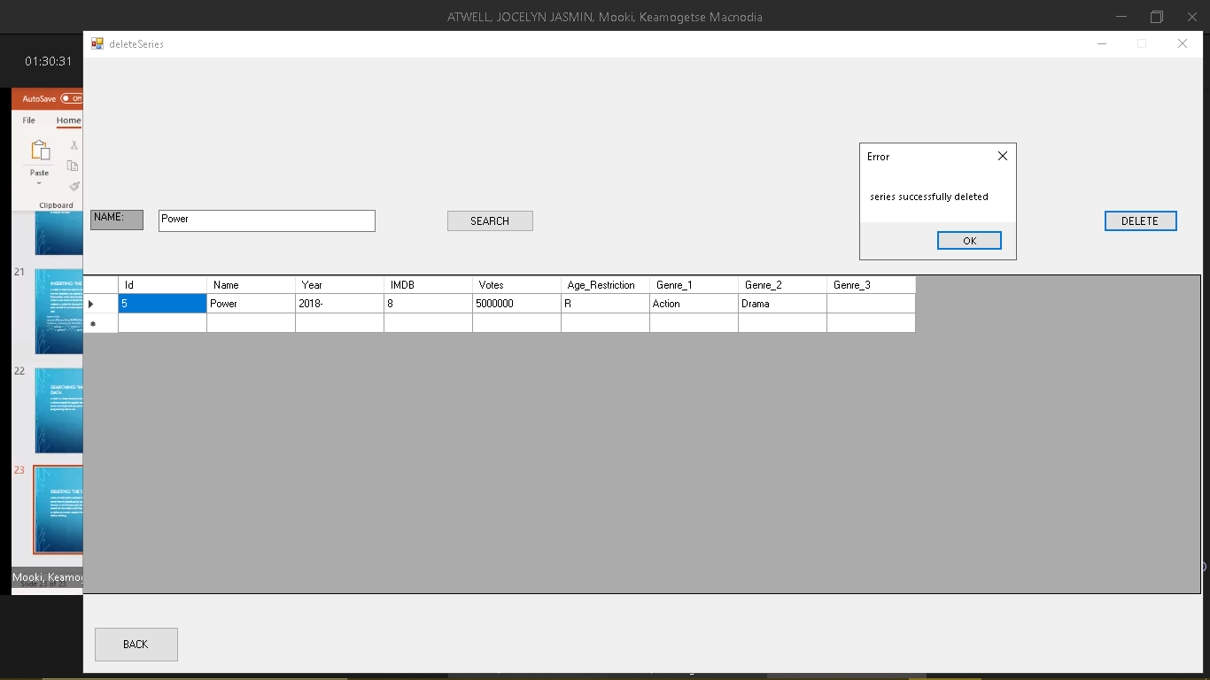
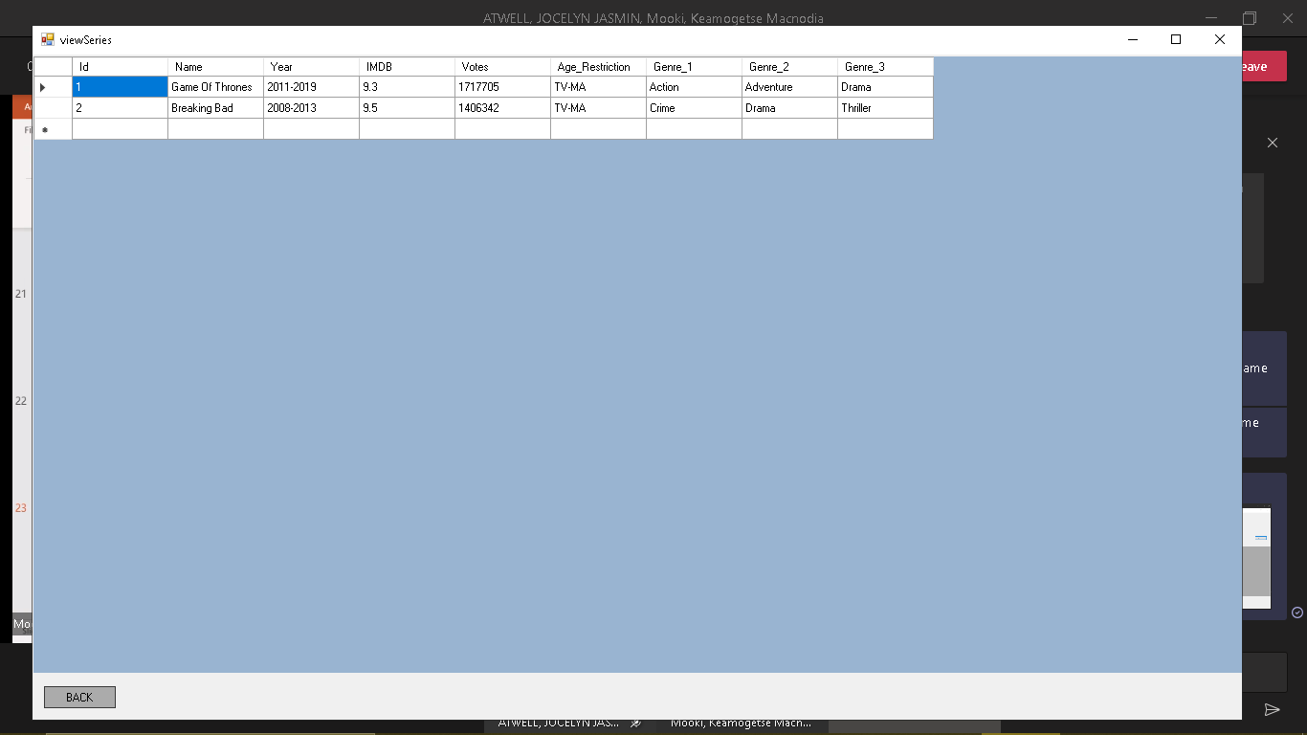
DELETING THE DATA
delete from series where name = '" + nameTxt.Text + "'
Users are also able to delete movies and series from the database by using the delete function. In this function users are able to search for the media which they would want to delete to in sure it exists in the database before deleting
delete from movies where name = '" + nameTxt.Text + "'

Slide 24
FUTURE POSSIBILITIES
This data application in future if developed further could be used by IMDB as a desktop application as right now they only have a mobile application.

